Slide 1
Built-in Functions
(String & Numeric)

Slide 2
SQL Function Types
There are two types of functions available in SQL.
They are:
  Single-row functions, and
  Multiple-row functions
Single-row functions produce one result per row. These functions can be used in SELECT, WHERE, and ORDER BY clause.
Multiple-row functions produce one result per group of rows. These functions are also called as group functions.

Slide 3
Single-Row Functions: Syntax
Single-row functions can be used in SELECT, WHERE, and ORDER BY clauses.
Syntax -
SELECT function_name(column|expression,[arg1,arg2,…])
FROM table;
Parameters
  function_name name of the function
  column|expression any named database column
  expression any character or calculated string
  arg list any arguments to be used by the
  function

Slide 4
Single-Row Functions: Types
There are five types of single-row functions
  String or Character
  Number
  Datetime
  Datatype Conversion
  General

Slide 5
Character Functions
Character functions accept character input and return either character values or numeric values. You can categorize single-row character functions into two types.
They are:
  Case-manipulation functions
  Character-manipulation functions

Slide 6
Case-manipulation Functions
These functions convert case for character strings.
These include:
  LOWER : Converts mixed case or uppercase character strings to lowercase.
  UPPER : Converts mixed case or uppercase character strings to uppercase.
  INITCAP : Converts the first letter of each word to uppercase ad remaining letter to lowercase

Slide 7
Character-manipulation Functions
Character-Manipulation functions manipulate character strings. Such functions include:
  CONCAT
  LENGTH
  SUBSTR
  LPAD
  RPAD
  REPLACE
  TRIM
  LTRIM
  RTRIM
  ASCII
  CHR
  GREATEST
  LEAST

Slide 8
CONCAT Function
The CONCAT function is used to concatenate the first character value to the second character value.
The CONCAT function is equivalent to the pipe (|) symbol.
Syntax –
Example –
SELECT CONCAT(firstName, lastName) As Name
FROM employees;
SELECT CONCAT(column1|expression1, column2|expression2)
FROM table_name;

Slide 9
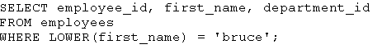
Using Case-Manipulation Functions
SELECT UPPER(FirstName)‏
FROM Employees;
SELECT LOWER(FirstName)‏
FROM Employees;
FIRSTNAME
FIRSTNAME
ola
OLA
tove
TOVE
kari
KARI
FIRSTNAME
SELECT INITCAP(FirstName)‏
FROM Employees;
Ola
Tove
Kari

Slide 10
LENGTH Function
The length function returns the number of characters in the column name value or in the expression.
Syntax -
Example –
SELECT lastName, LENGTH(lastName) As Length
FROM employees;
SELECT LENGTH(column_name|expression)
FROM table_name;

Slide 11
SUBSTR Function
Syntax –
The SUBSTR function returns a part of a string depending on its second and third argument.
The second value (m) refers to the position from which the string is to be retrieved. If the second value is negative, the Oracle server counts backwards from the end of the string.
The third optional value (n) is the total length of the returned string. If n’s value is less than one, then NULL is returned.
The default value of both m & n is 1.
SELECT SUBSTR(column|expression, m,[n])
FROM table_name;

Slide 12
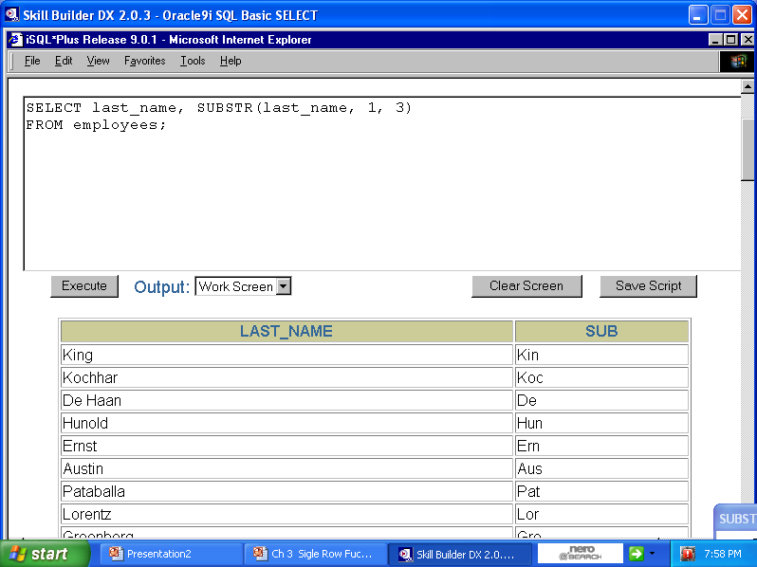

Slide 13
INSTR Function
Syntax –
The INSTR function is used to return the numeric position of a named string.
We specify two values as input arguments. They are
    The first value is the string to search
    The second value is the substring to search in first string
    m – position to start searching
    nth appearance of the substring.
If the search is unsuccessful, the return value is zero.
SELECT INSTR(column_name|expression, string, [m],[n ])
FROM table_name;

Slide 14
Example : INSTR
INSTR(‘tech on the net’, ’e’)
returns 2
INSTR(‘tech on the net’, ’e’,1,1)
returns 2, 1st occurrence of e
INSTR(‘tech on the net’, ’e’,1,2)
returns 11, 2nd occurrence of e
INSTR(‘tech on the net’, ’e’,1,3)
returns 14, 3rd occurrence of e
INSTR(‘tech on the net’, ’e’,-3,2)
returns 2

Slide 15
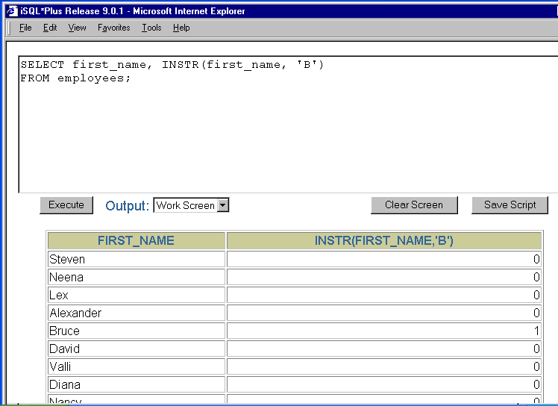

Slide 16
LPAD Function
Syntax –
LPAD returns string1, left-padded to length n with the sequence of characters in string2.
If string1 is longer than n, LPAD returns the portion of string1 that fits in n.
The argument n is the total length of the returned value.
If string2 is omitted, blanks are appended from the left of string1
Example
SELECT lastName, LPAD(job_Id, 10, ‘*’)
FROM employees;
SELECT LPAD(string1, n[,string2])
FROM table_name;

Slide 17
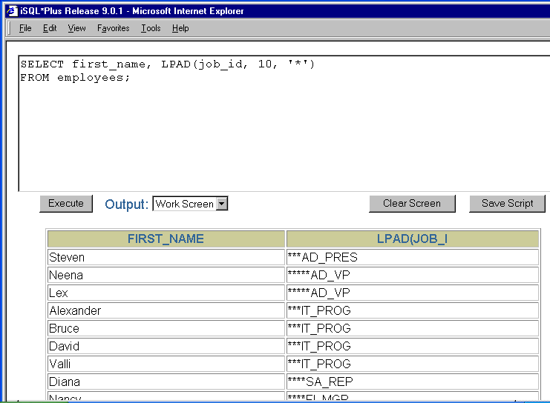

Slide 18
RPAD Function
Syntax –
RPAD returns char1, right-padded to length n with the sequence of characters in char2.
If char1 is longer than n, RPAD returns the portion of char1 that fits in n.
The argument n is the total length of the returned value.
Example
SELECT lastName, RPAD(job_Id, 10, ‘*’)
FROM employees;
SELECT RPAD(char1, n[,char2])
FROM table_name;

Slide 19
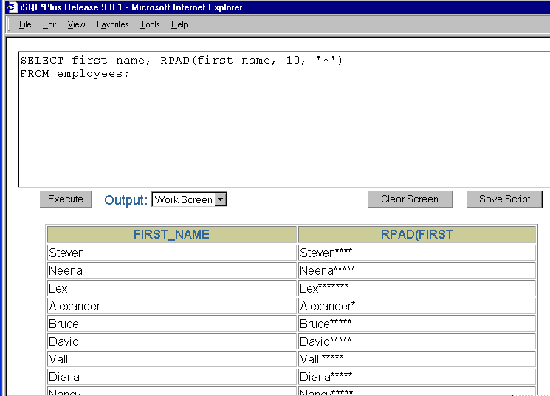

Slide 20
REPLACE Function
Syntax –
The REPLACE function is used to search for a character string in a text expression.
If the character string is found, then the function replaces it with the specified replacement string.
Example
SELECT REPLACE(lastName, ‘Roy’, ‘Rai’)‏
FROM employees;
SELECT REPLACE(text, search_string, replacement_string)
FROM table_name;

Slide 21
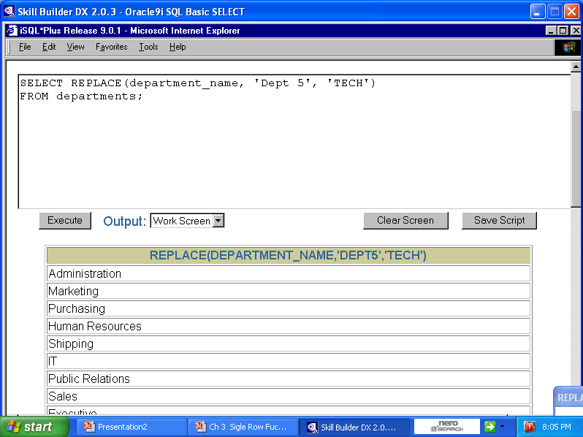

Slide 22
TRIM Function
Syntax –
TRIM function is used to trim leading or trailing characters, or both, or space from a character string.
We can specify three input arguments in a TRIM function.
  The first argument is the leading or trailing characters or both(default)
  The second argument is the trim_character that you want to trim followed by the FROM clause.
  The last argument is the trim_source.
Example
SELECT lastName, TRIM(‘B’ FROM firstName)
FROM employees;
SELECT TRIM([leading|trialing|both] trim_character FROM trim_source)
FROM table_name;

Slide 23
Examples : TRIM()
trim('m' from dept_name)
trim(leading 'm' from dept_name)
trim(trailing 'm' from dept_name)
trim(trailing from dept_name)
trim(leading from dept_name)
trim(dept_name)
Take dept_name = ‘madam’

Slide 24
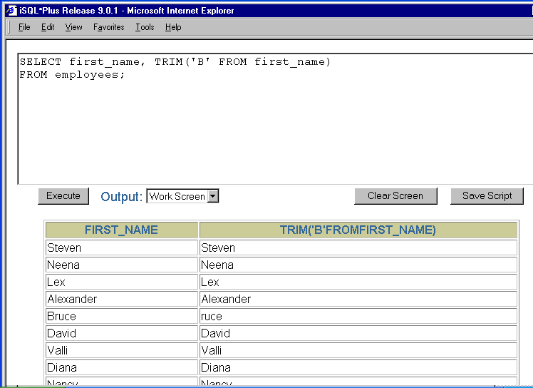

Slide 25
LTRIM Function
Syntax
SELECT LTRIM(expression[, string])
FROM table_name;
The LTRIM function is used to remove the leading blank characters from an expression or any characters appearing in the string from the left.
Parameters are
  expression - Any data type of expressions. If it isn't a binary type then it will convert first to a string data type.
  Return-type - A character string or binary data type depending on the data type of the expression.
Example
SELECT LTRIM( ‘ Peter' )
FROM dual;
Result: Peter
SELECT LTRIM( ‘32;Peter‘,’23;’ )
FROM dual;
Result: Peter

Slide 26
RTRIM Function
Syntax –
        SELECT RTRIM(expression[,string])
        FROM table_name;
The RTRIM function is used to remove the trailing blank character from an expression or any characters appearing in the string from the left.
Parameters are
  expression - Any data type of expressions. If it isn't a binary type then it will convert first to a string data type.
  Return-type - A character string or binary data type depending on the data type of the expression.
Example
SELECT LTRIM( 'Peter ' )
FROM dual;
Result: Peter
Example
SELECT LTRIM( 'Peter;23‘,’3;2’ )
FROM dual;
Result: Peter

Slide 27
ASCII Function
Syntax –
The CHR function converts an integer value to its equivalent ASCII character.
Parameters are
  String - Any string expression.
  Return-type – An integer value.
Example
SELECT ASCII('A')
FROM dual;
Return Value: 65
SELECT ASCII(string)
FROM table_name;

Slide 28
CHR Function
Syntax –
The CHR function converts an integer value to its equivalent ASCII character.
Parameters are
  expression - Any integer value.
  Return-type – A character.
Example
SELECT CHR(65)
FROM dual;
Return Value: A
SELECT CHR(expression)
FROM table_name;

Slide 29
GREATEST Function
LEAST Function
(self-study)‏

Slide 30
Number Functions
Number functions accept numeric data as input arguments and return numeric values.
The most commonly used number functions are displayed below.
  CEIL
  POWER
  ROUND
  TRUNC
  MOD
  SQRT
  BITAND
  EXP
  FLOOR
  LN
  SIGN

Slide 31
CEIL Function
Syntax –
The function CEIL returns the next integer value for the numeric expression.
Parameters are
  expression - Any numeric expression.
  Return-type – An integer value.
Example
SELECT CEIL(1.3)
FROM dual;
Return Value: 2
SELECT CEIL(expression)
FROM table_name;

Slide 32
POWER Function
Syntax –
The function POWER returns the exponential value for the numeric expression.
Parameters are
  number - Any numeric expression.
  power – Any numeric expression.
  return-type - float
Example
SELECT POWER(2.0,3.0)
FROM dual;
Return Value: 8.0
SELECT POWER(number, power)
FROM table_name;

Slide 33
ROUND Function
Syntax –
The ROUND function rounds the column, expression, or value to n decimal places.
Parameters are
  The first parameter is the column name or an expression.
  The second parameter is the number of decimal places to which you want to round off the value
SELECT ROUND(column_name|expression,n)
FROM table_name;

Slide 34
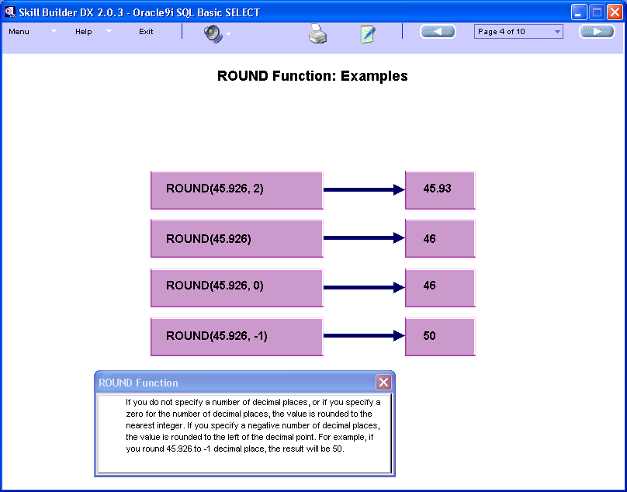
Example: ROUND()

Slide 35
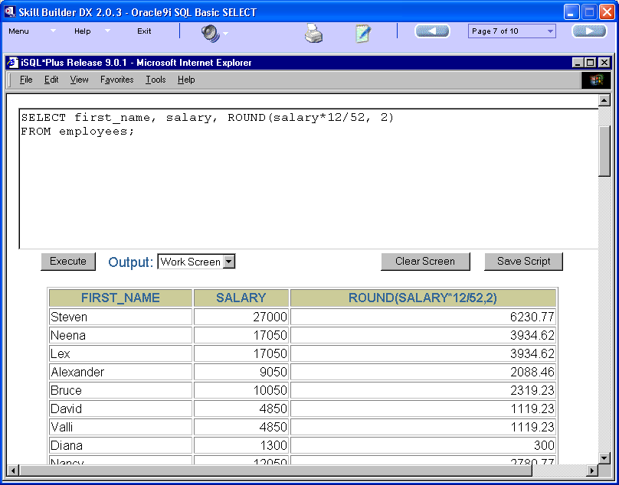

Slide 36
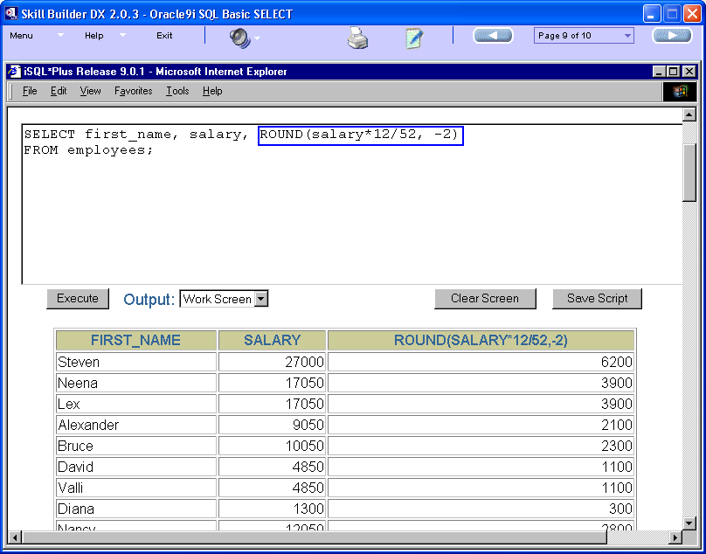

Slide 37
TRUNC Function
Syntax –
The TRUNCATE function is used to truncate the column, expression or value to the specified number of decimal places.
Parameters are:
  The first parameter is the column or expression.
  You specify the number of decimal places as the second parameter.
SELECT TRUNC(column_name|expression,n)
FROM table_name;

Slide 38
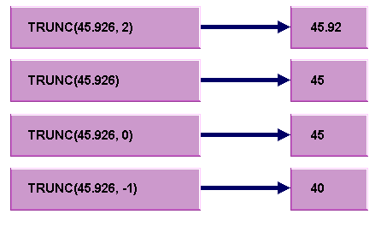
Example : TRUNC

Slide 39
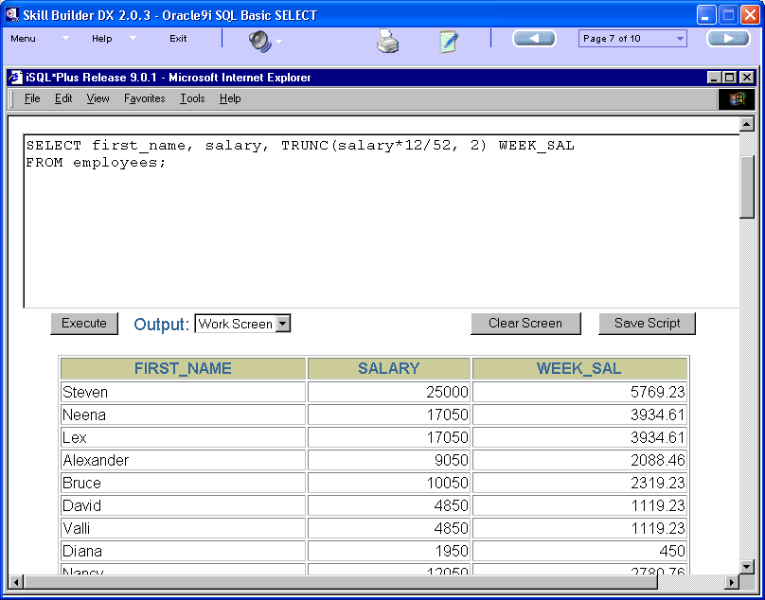

Slide 40
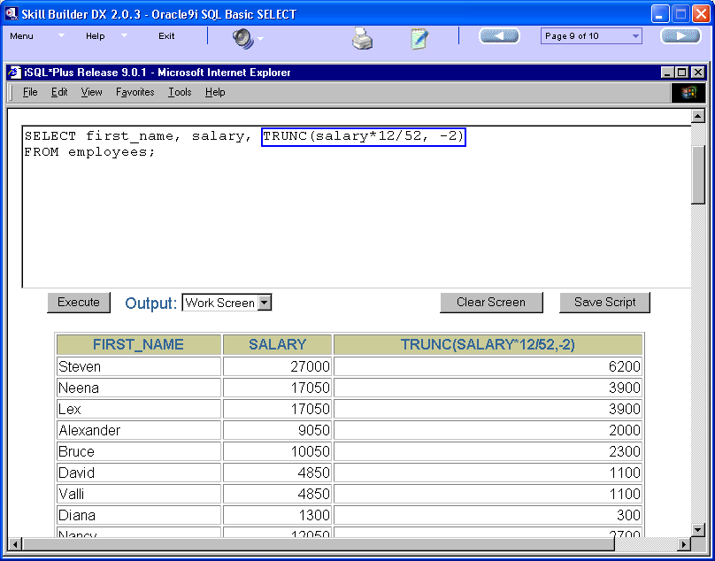

Slide 41
MOD Function
Syntax –
The MOD function finds the remainder of one value (m) divided by a second value (n).
The function requires two parameters to be specified in the MOD function.
For example, you can use the MOD function to determine if a value is odd or even.
SELECT MOD(m,n)
FROM table_name;

Slide 42
Example: MOD()
SELECT MOD(salary, 10)
If salary=1299, MOD() returns 9
        10) 1299 (129
        10
        29
        20
        99
        90
        9

Slide 43
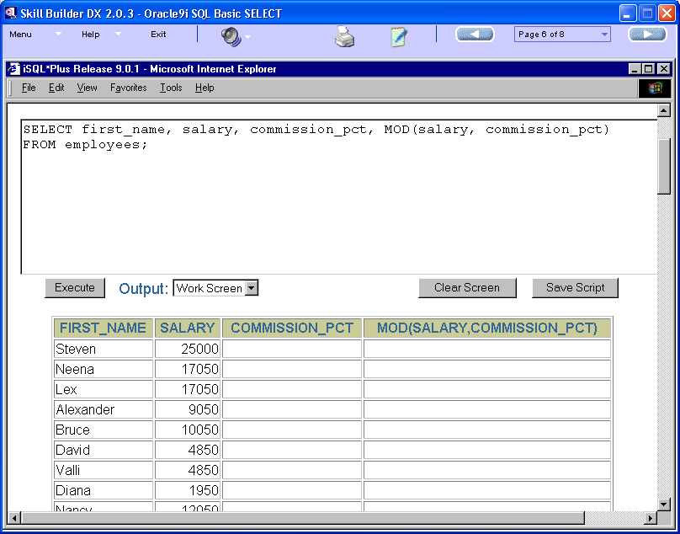

Slide 44
SQRT Function
Syntax –
The function SQRT returns the square root value for the numeric expression.
Parameters:
  Number – any numeric expression
  Return-type – float
Example
SELECT SQRT(4.0)
FROM dual;
Returns: 2.0
SELECT SQRT(number)
FROM table_name;

Slide 45
EXP Function
Syntax –
The function EXP returns the exponential value for the numer ic expression.
This is like the power function with a base e.
Parameters:
  Number – any numeric expression
  Return-type – float
Example
SELECT EXP(0)
FROM dual;
Returns: 1
SELECT EXP(number)
FROM table_name;

Slide 46
FLOOR Function
Syntax –
The function FLOOR returns the previous integer value for the numeric expression.
This is like the power function with a base e.
Parameters:
  Number – any numeric expression
  Return-type – int
Example
SELECT FLOOR(1.3)
FROM dual;
Returns: 1
SELECT FLOOR(number)
FROM table_name;

Slide 47
SIGN Function
Syntax –
The function SIGN returns the sign for the numeric expression.
It returns a value of
  -1 for negative expressions
  0 for zero expressions, and
  +1 for positive expressions.
  NULL for null expressions
Parameters:
  Number – any numeric expression
  Return-type – int
Example
SELECT FLOOR(4)
FROM dual;
Returns: 1
SELECT SIGN(number)
FROM table_name;

Slide 48
BITAND Function
LN Function
(self – study)‏

